Slide 1

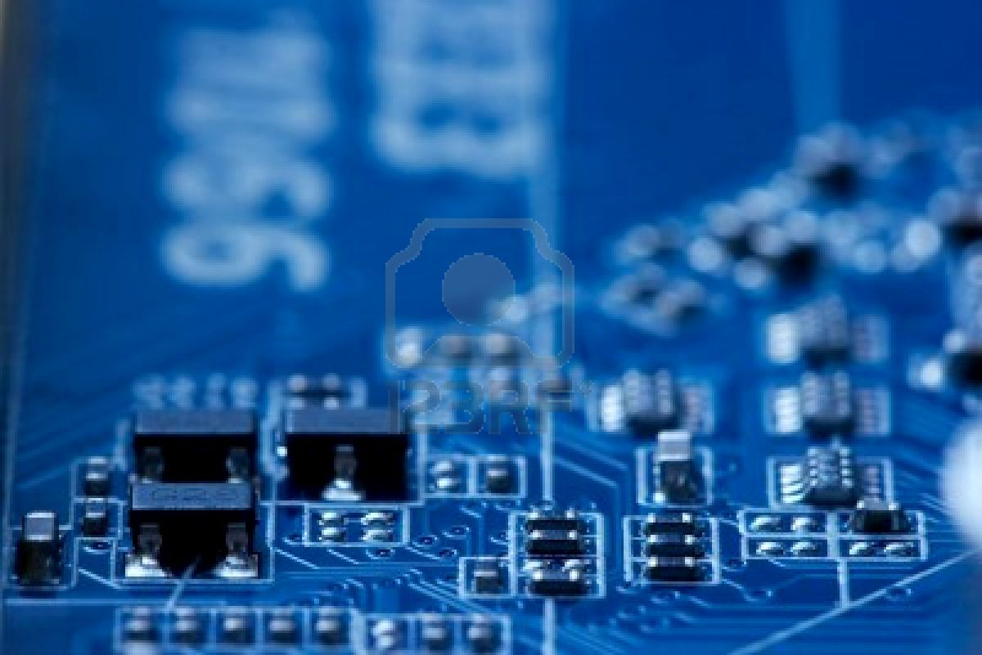
Society of Robotics and Automation, VJTI
Understanding the Development Board

Slide 2
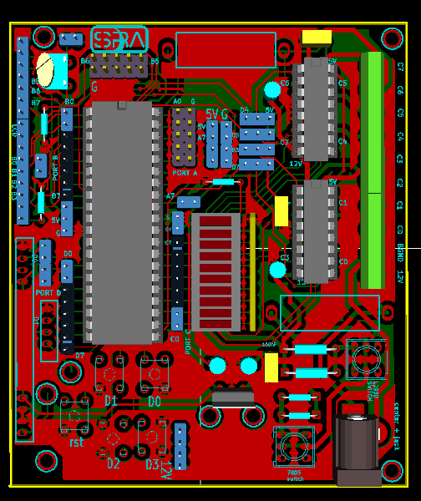
3D layout of the Development Board

Slide 3
The Microcontroller

Slide 4
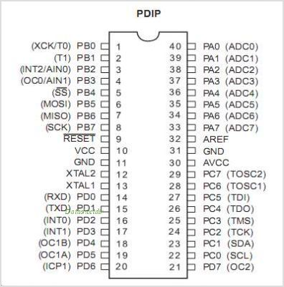
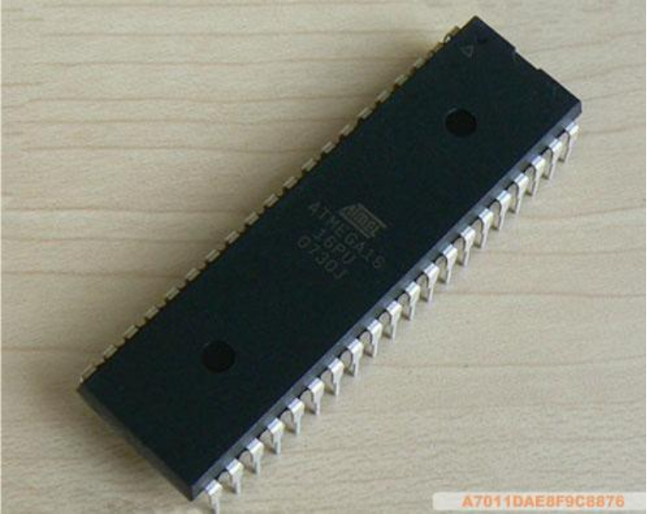
ATMEGA 16

Slide 6
Voltage Regulation

Slide 7
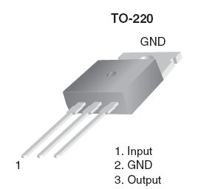
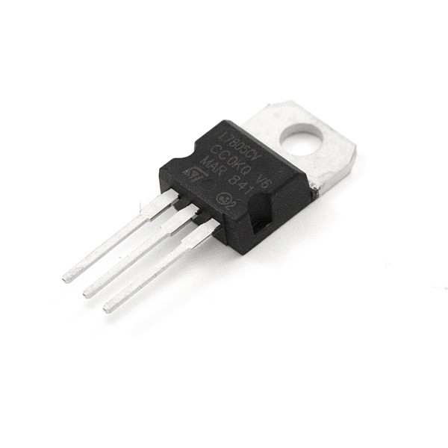
Voltage Regulator – LM 7805

Slide 8
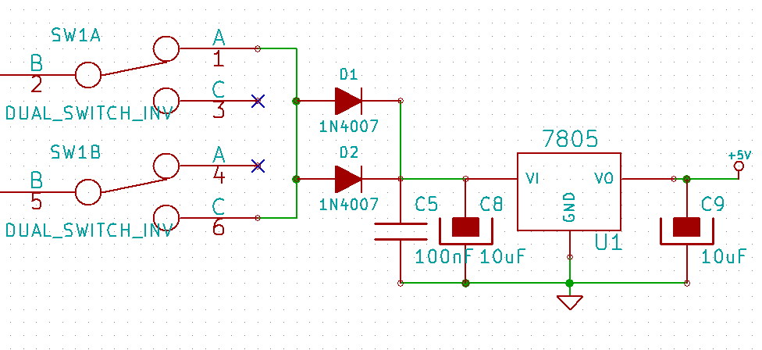

Slide 10
Motor Drivers

Slide 11
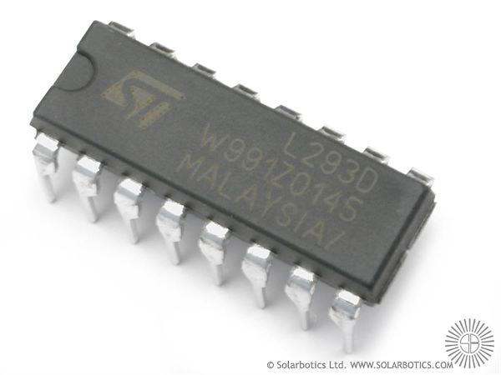
L293D
Motor drivers are essentially little current amplifiers; their function is to take a low-current control signal, and turn it into a proportionally higher-current signal that can drive a motor.

Slide 12
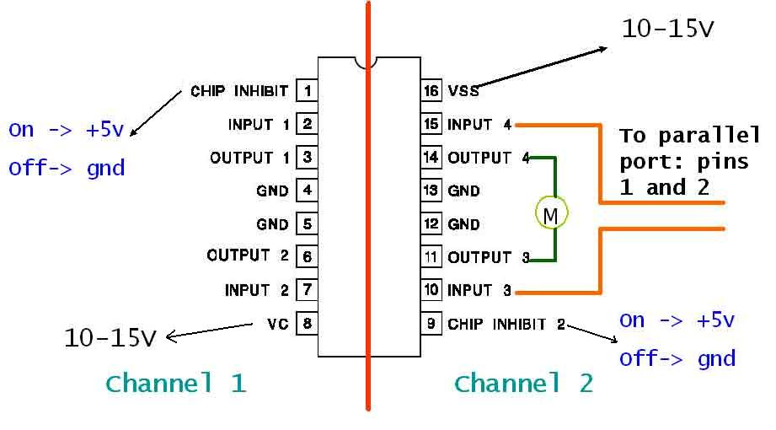
5v5 V

Slide 13
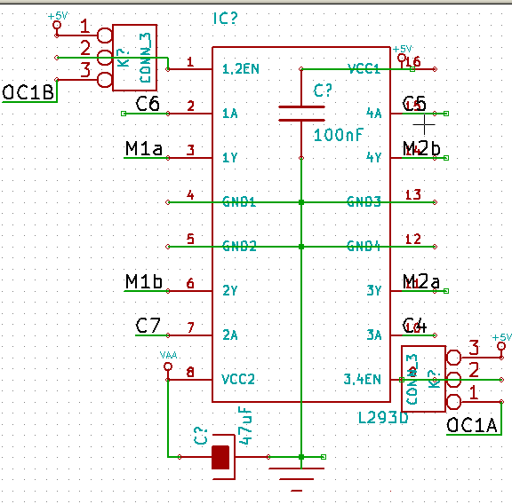
L293d connections

Slide 14
PWM Pins

Slide 15
Display Devices

Slide 16
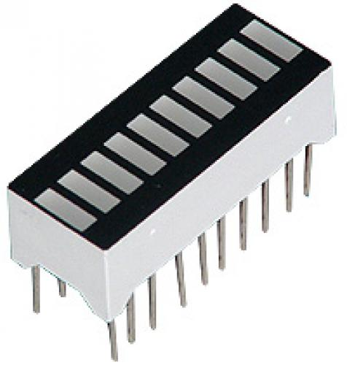
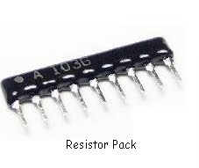
LED PACK
RESISTOR PACK

Slide 17
LED Pack
Resistor Pack

Slide 18
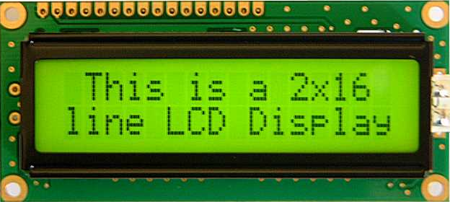
LCD Display

Slide 19
Provision for LCD Display

Slide 20
Switches on the board

Slide 21
OTHER CONNECTIONS
SWITCH FROM
12V TO L293D
RESET SWITCH
SWITCHES TO
PINS D0,D1,D2
AND D3
SWITCH FROM
12V TO 7805

Slide 22
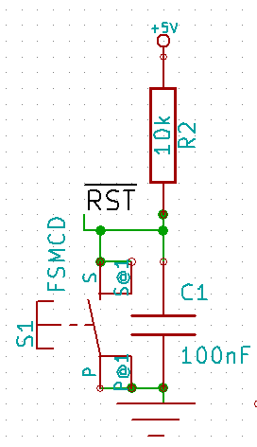
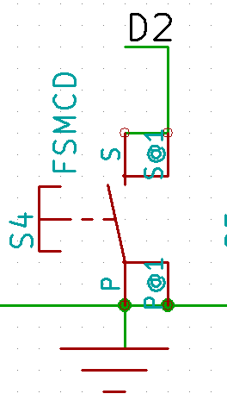
Reset switch connections
Other switch

Slide 23
Additional Features

Slide 24
200mA Fuse
FT232/CP2102 - UART
3A Fuse
Provision
for RF - RX
and TX

Slide 25
THANK YOU! ☺
www.sra.vjti.info

